Slide 1
JIPYEONJEON
SSMBA: Self-Supervised Manifold Based Data Augmentation for Improving Out-of-Domain Robustness
집현전 중급반
https://github.com/jiphyeonjeon
발표자 : 박동주
https://github.com/toriving

Slide 2

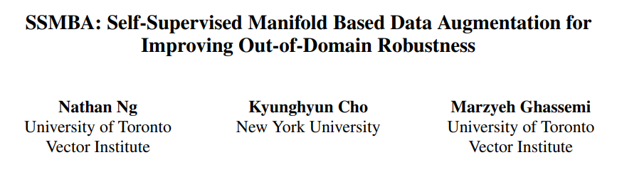
About
JIPHYEONJEON
EMNLP2020 – Long paper
Topic : Data augmentation
Paper : https://www.aclweb.org/anthology/2020.emnlp-main.97.pdf
Code : https://github.com/nng555/ssmba
https://toriving.github.io/SSMBA-Self-Supervised-Manifold-Based-Data-Augmentation-for-Improving-Out-of-Domain-Robustness
01

Slide 3
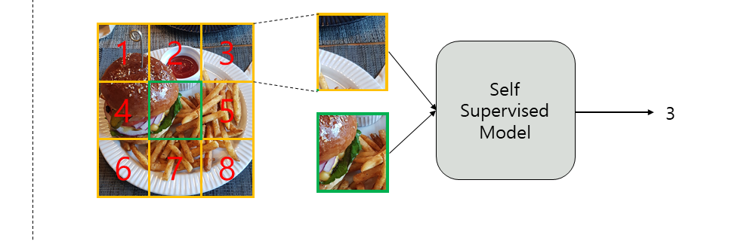
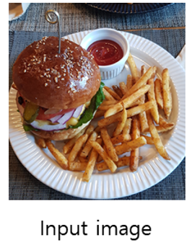
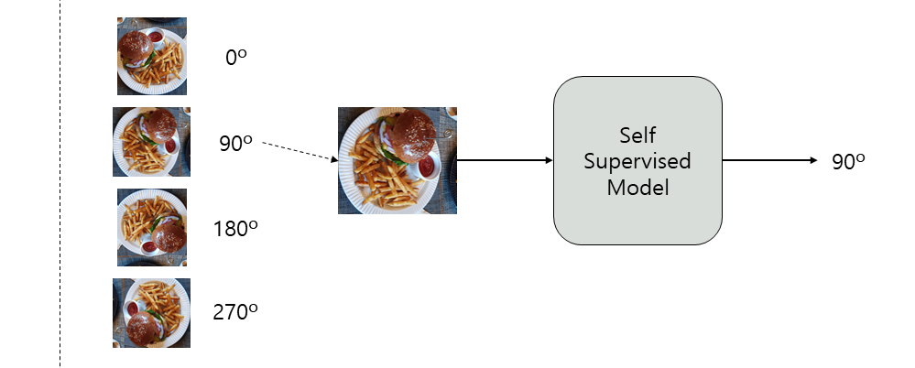
Self-Supervised Learning – Computer Vision
JIPHYEONJEON
01

Slide 4
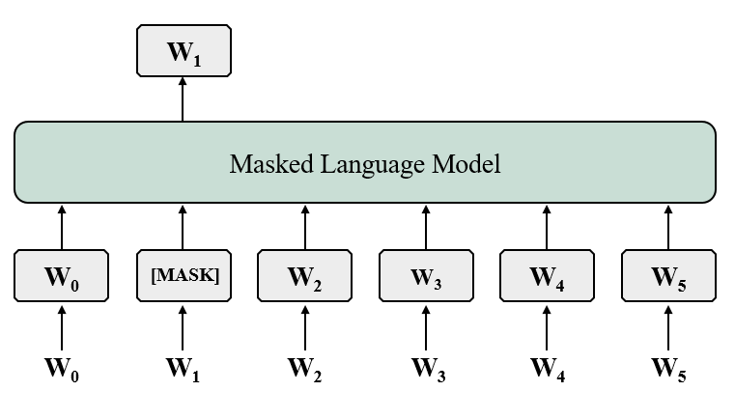
Self-Supervised Learning – Natural Language Processing
JIPHYEONJEON
Natural Language Processing
01

Slide 5
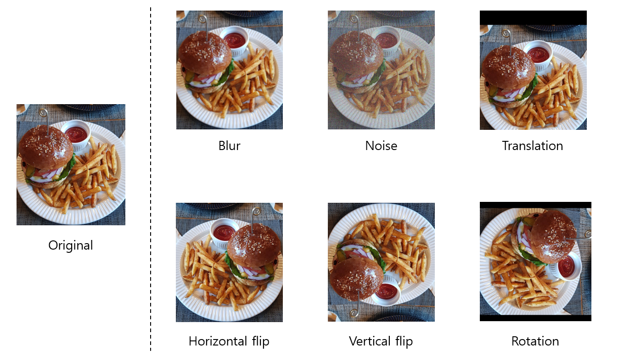
Data Augmentation – Computer Vision
JIPHYEONJEON
01

Slide 6
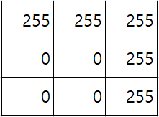

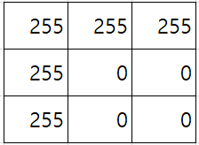

Data Augmentation – Computer Vision
JIPHYEONJEON
Rotation
01

Slide 7
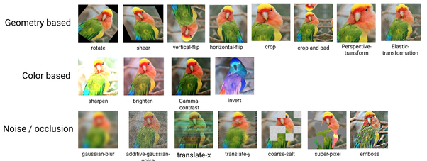
Data Augmentation – Computer Vision
JIPHYEONJEON
01

Slide 8
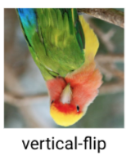
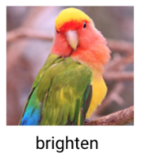
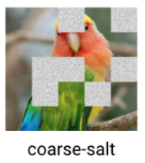
Data Augmentation – Natural Language Processing
JIPHYEONJEON
I go to school by bus
I go to ????? by bus
I go to school by bus
01

Slide 9
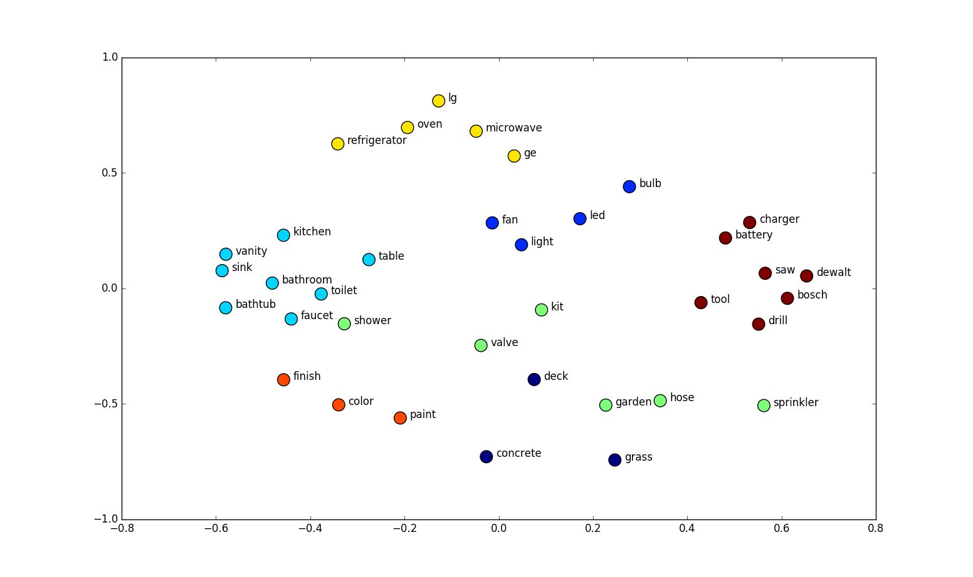
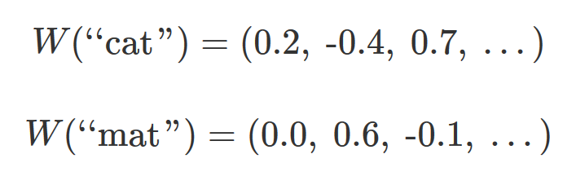
Data Augmentation – Natural Language Processing
JIPHYEONJEON
01

Slide 10
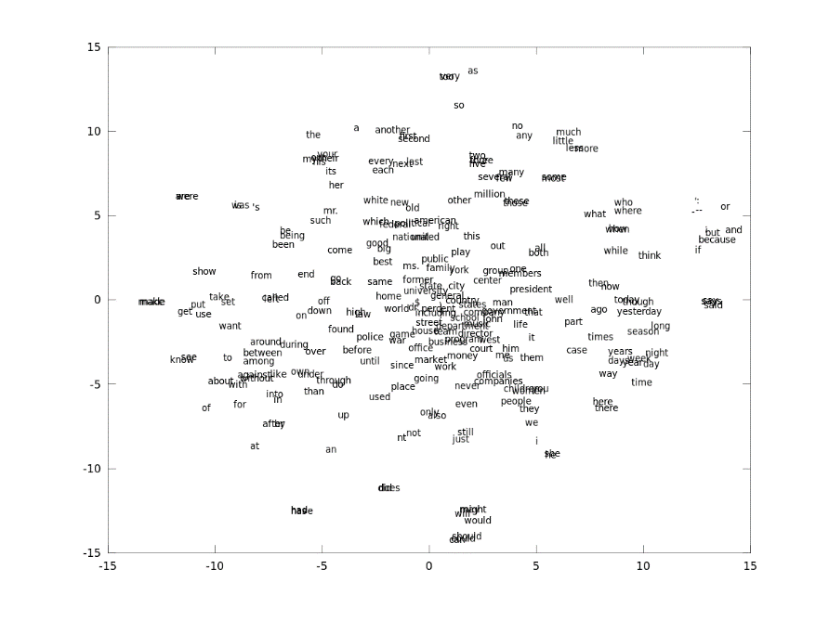
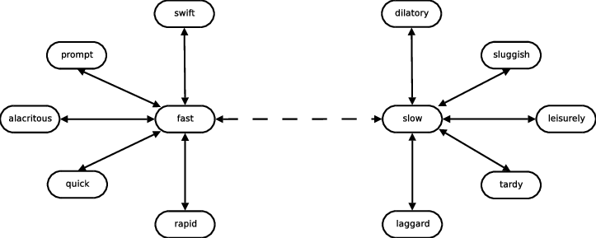
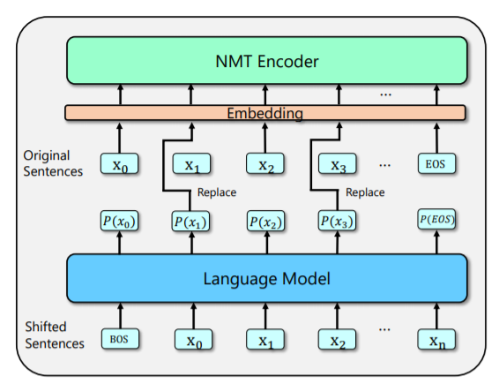
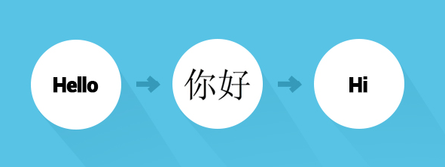
Data Augmentation – Natural Language Processing
JIPHYEONJEON
01

Slide 11
Introduction
JIPHYEONJEON
Training distributions often do not cover all of the test distributions we would like a supervised classifier or model to perform well on.
Therefore, a key challenge in training machine learning models in these settings is ensuring they are robust to unseen examples.
If data concentrates on a low-dimensional manifold then these synthetic examples should lie in a manifold neighborhood of the original examples.
However, in domains such as natural language, it is much more difficult to find a set of invariances that preserves meaning or semantics.
01

Slide 12
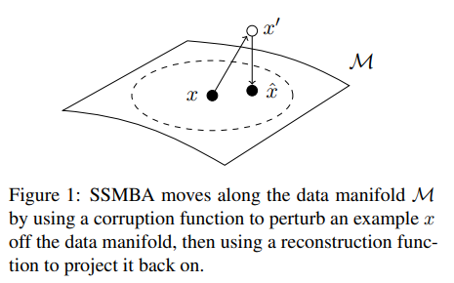
Introduction
JIPHYEONJEON
Self-Supervised Manifold Based Data Augmentation (SSMBA): a data augmentation method for generating synthetic examples in domains where the data manifold is difficult to heuristically characterize.
Motivation : Denoising auto-encoders
Corruption fuction : Stochastically perturb examples off the data manifold
Reconstruction function : Project them back on.
01

Slide 13
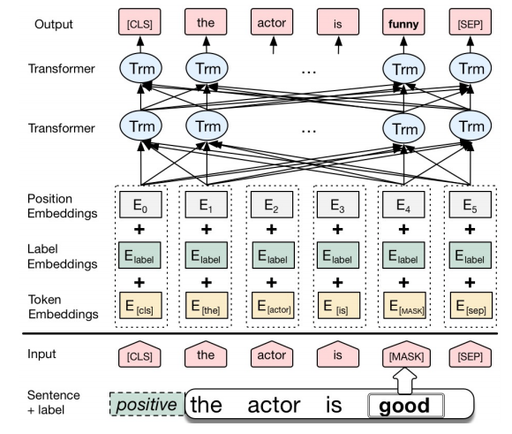
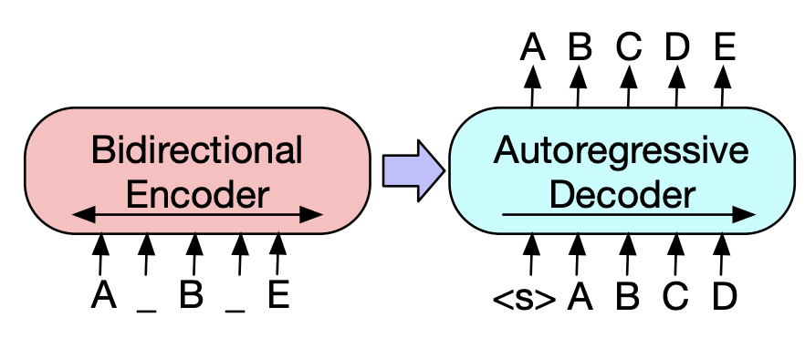
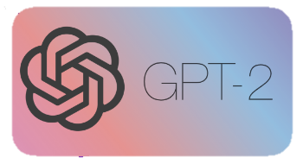
Background and Related Work
JIPHYEONJEON
Data Augmentation in NLP
Existing work on improving generalization has focused on data augmentation, where synthetically generated training examples are used to augment an existing dataset.
It is hypothesized that these examples induce robustness to local perturbations, which has been shown to be effective in semi-supervised and self-supervised settings.
01

Slide 14
Background and Related Work
JIPHYEONJEON
VRM and the Manifold Assumption
Existing work on improving generalization has focused on data augmentation, where synthetically generated training examples are used to augment an existing dataset.
It is hypothesized that these examples induce robustness to local perturbations, which has been shown to be effective in semi-supervised and self-supervised settings.
01

Slide 15
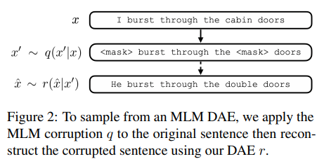
Background and Related Work
JIPHYEONJEON
01

Slide 16
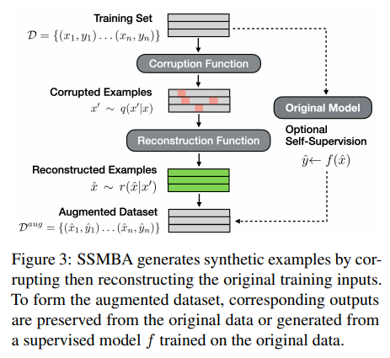
Data Augmentation – Natural Language Processing
JIPHYEONJEON
01

Slide 17
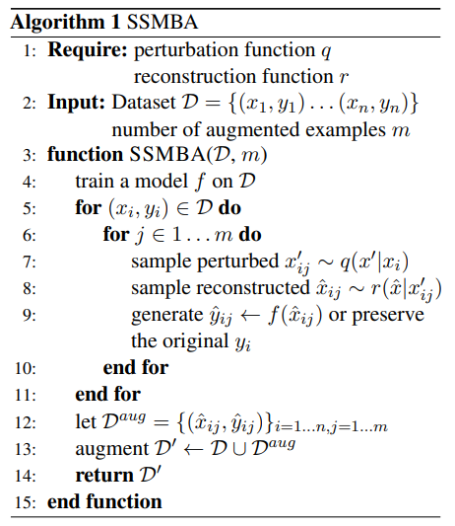
Data Augmentation – Natural Language Processing
JIPHYEONJEON
01

Slide 18
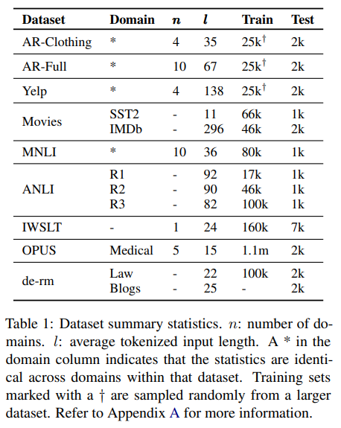
Data Augmentation – Natural Language Processing
JIPHYEONJEON
01

Slide 19
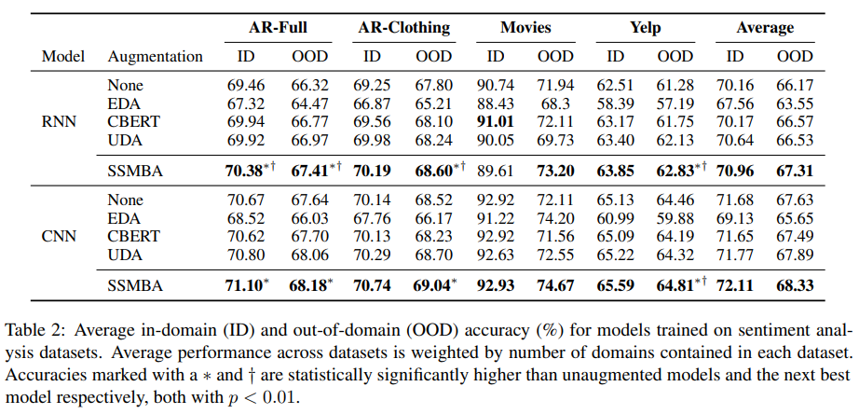
Data Augmentation – Natural Language Processing
JIPHYEONJEON
01

Slide 20
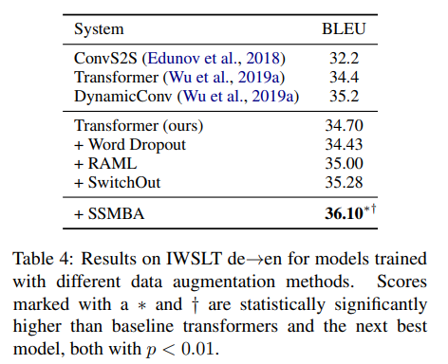
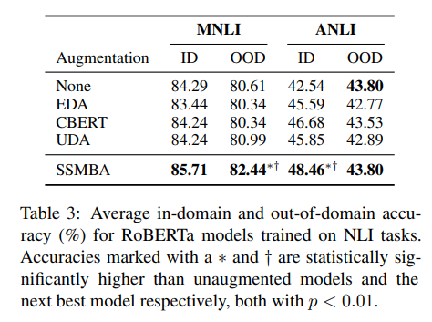
Data Augmentation – Natural Language Processing
JIPHYEONJEON
01

Slide 21
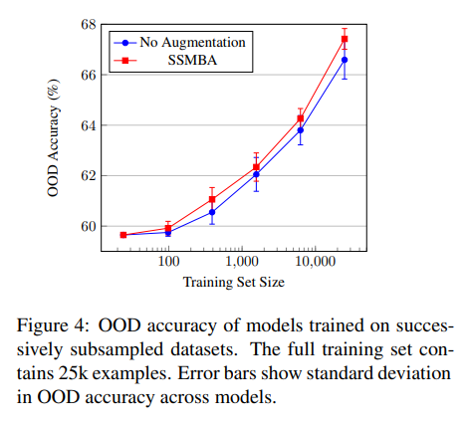
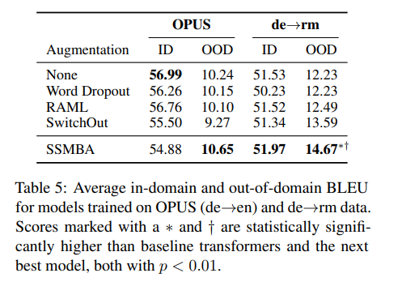
Data Augmentation – Natural Language Processing
JIPHYEONJEON
01

Slide 22
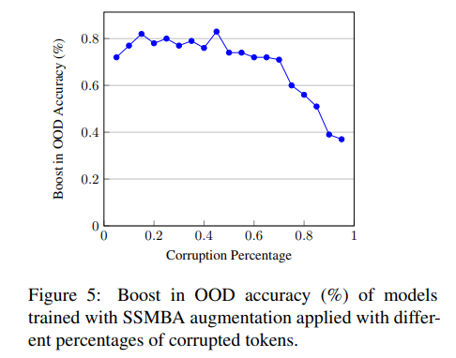
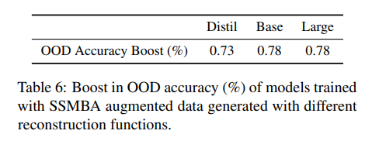
Data Augmentation – Natural Language Processing
JIPHYEONJEON
01

Slide 23
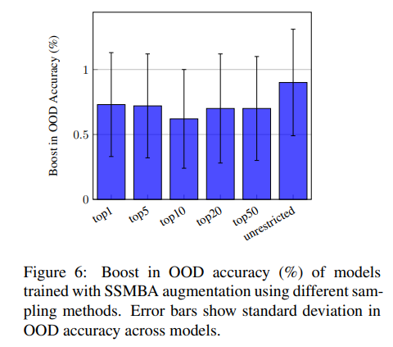
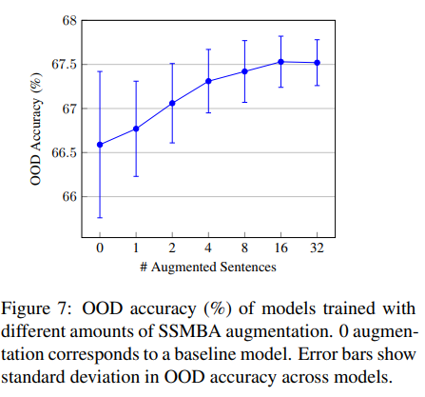
Data Augmentation – Natural Language Processing
JIPHYEONJEON
01

Slide 24
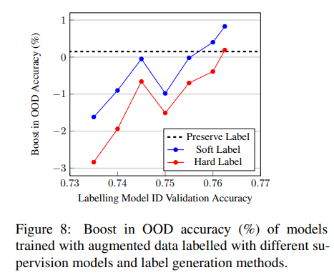
Data Augmentation – Natural Language Processing
JIPHYEONJEON
01

